Slide 1




CT&M Development Workstream Weekly Status Report
Status Period: January 08, 2024- January 12, 2024
January 16, 2024

Slide 2


Current
CT&M Dev: Overall Status
Previous
PMO
Program Status | Key Accomplishments
Upcoming Activities
*RAG Breakdown
Status Summary: We are in Red status due to the main reasons our lack of dev readiness, risk to quality of scaling Career Canvas, and expected delay of the CT site workstreams due to Indeed Job API issue
Key Accomplishments:
Merge and Regression week
Sprint 1 Planning
Data as an Asset business requirements + quick wins document signed off.
Planning the quick wins for CR
Sprint 1 Development
KPI | *RAG | Mitigation
Schedule | R | Dev Readiness: Mitigation pending.
Resource/ Budget | G
Scope | G
Quality | R | Managing risk to quality closely with sponsors
*RAG | IT Workstream | Description​ | Target Date​
 | TextKernel API Architecture Simplification | Solutions documented and sized. Presentation for business ready. Decision/sign off on the next steps pending in the next two weeks. (Indeed Jobs API impacted the solutioning). | Discovery phase done. Next Phase - TBD.
 | Data as an Asset | Discovery: Deliverables reviewed and signed off, including the Quick wins definition to start planning. | Discovery phase closed. Next one -TBD
 | CT Site CV/Resume Builder & Branding |  | Pending Discovery
 | CT Site Jobs |  | Pending Discovery
 | Career Canvas Overall/Integration to New CT Site |  | Pending Discovery
 | Career Canvas Scale up Into CRN |  | Pending Discovery
 | Coaching |  | Pending Discovery
 | Dashboard |  | Pending Discovery
*For definition of RAG status, see here.
Notes:
Please copy wash.

Slide 3
CT&M Dev: Risks and Issues
PMO
*RAG | Description | Impact | Options | Target Resolution | Owner
 | Adequate Product backlog not ready for development. The impact will be consumption of development capacity by lower priority work for the scrum teams. | Pending milestones list for addressing this issue | TBD | George
 | Our customer is asking for us to scale the Career Canvas feature much faster than we believe is possible. This could result in a sub-quality version of the prototype. Alex, Geoff, and Matt are managing these expectations with Iza and John Morgan. | Managing expectations and individual risks associated with this overall risk | TBD | Geoff
 | Indeed Jobs API is at risk and set to be removed in Feb 2024. This could breach our contracts with our customers. It was previously removed but was reinstated temporarily. There is no support of the API should we have any issues. This also puts our CT site work at risk for delay. This further could impact all candidates and colleagues, as development might not be completed in March Release and spill over to April release. | Geoff mentioned to re-negotiate on this. Geoff negotiated an extension till March end while we are working on alternative solution. They can send an XML job feed. They will send us details so that the tech team can review but it does not sound like an ideal tech solution. They will also indicate the volume of jobs and global coverage provided. We can evaluate this as one of a few potential options." | January end | Geoff
*For definition of RAG status, see here.
Notes:
Please copy wash.

Slide 4
CT&M Dev: Milestone Status
PMO
*Health | Factory Milestone​ | Start Date​ | Target Date​ | Adjusted Target Date​ | Status | Action Plan / Notes​
 | January 26 Release | 01-Sep | 26-Jan |  | In Progress
 | Planning & Development | 01-Sep | 05-Jan |  | Complete
 | Code Merge & Regression Testing | 08-Jan | 12-Jan |  | Complete
 | User Acceptance Testing | 15-Jan | 19-Jan |  | In Progress
 | Release – Deploy to Production | 26-Jan | 26-Jan |  | Not Started
 | March 01 Release | 23-Oct | 01-Mar |  | In Progress
 | Planning | 30-Oct | 24-Jan |  | In Progress
 | Feature Assignment | 23-Oct | 17-Nov | 03-Jan | In Progress
 | Story Writing | 20-Nov | 15-Dec 29-Dec | 10-Jan 24-Jan | In Progress
 | Tech Refinement | 18-Dec | 10-Jan 24-Jan |  | In Progress
 | Sprint 01 | 15-Jan | 26-Jan |  | In Progress
 | Sprint 02 | 29-Jan | 09-Feb |  | Not Started
 | Code Merge & Regression Testing | 12-Feb | 16-Feb |  | Not Started
 | User Acceptance Testing | 19-Feb | 23-Feb |  | Not Started
 | Release – Deploy to Production | 01-Mar | 01-Mar |  | Not Started
*For definition of RAG status, see here.
Notes:
Please copy wash.

Slide 5
CT&M Dev: Milestone Status
PMO
*RAG | Workstream Milestone​ | Start Date​ | Target Date​ | Adjusted Target Date​ | Status | Action Plan / Notes​
 | April 05 Release | 27-Nov | 5-Apr |  | In Progress
 | Planning | 27-Nov | 28-Feb |  | In Progress
 | Feature Assignment | 27-Nov | 22-Dec |  | In Progress
 | Story Writing | 25-Dec | 19-Jan 2-Feb |  | Not Started
 | Tech Refinement | 22-Jan | 14-Feb 28-Feb |  | Not Started
 | Sprint 01 | 19-Feb | 1-Mar |  | Not Started
 | Sprint 02 | 4-Mar | 15-Mar |  | Not Started
 | Code Merge & Regression Testing | 18-Mar | 22-Mar |  | Not Started
 | User Acceptance Testing | 25-Mar | 29-Mar |  | Not Started
 | Release – Deploy to Production | 5-Apr | 5-Apr |  | Not Started
*For definition of RAG status, see here.
Notes:
Please copy wash.

Slide 6
CT&M Dev: Milestone Status
PMO
*RAG | Workstream Milestone​ | Start Date​ | Target Date​ | Adjusted Target Date​ | Status | Action Plan / Notes​
 | May 10 Release | 02-Jan | 10-May |  | Not Started
 | Planning | 02-Jan | 3-Apr |  | Not Started
 | Feature Assignment | 08-Jan | 02-Feb |  | Not Started
 | Story Writing | 29-Jan | 23-Feb 8-Mar |  | Not Started
 | Tech Refinement | 26-Feb | 20-Mar 3-Apr |  | Not Started
 | Sprint 01 | 25-Mar | 05-Apr |  | Not Started
 | Sprint 02 | 8-Apr | 19-Apr |  | Not Started
 | Code Merge & Regression Testing | 22-Apr | 26-Apr |  | Not Started
 | User Acceptance Testing | 29-Apr | 03-May |  | Not Started
 | Release – Deploy to Production | 10-May | 10-May |  | Not Started
*For definition of RAG status, see here.
Notes:
Please copy wash.

Slide 7
CT&M Dev: Architects Planning Update
Matt
March Release
*RAG | Epic Name | PBI # | Architect | Roadmap/ Topic Item | Feature Estimate | User Story Status | Path to Green
G | Candidate Portal - Consuming a SmartLink | 202266 | Raj | New CT – Candidate Portal | 25 | Ready For Decomp | Sizing done. Tech stories are in progress.
G | Candidate Portal - Backend for Landing/Login page admin | 206031 | Raj | New CT – Candidate Portal | 11 | Ready for Decomp | Sizing done. Design completed. Decomposition is in progress..
G | Candidate Portal - Upload Landing page white labelling configuration to BLOB | 206182 | Raj | New CT – Candidate Portal | 15 | Ready for Decomp | Sizing done. Design completed. Decomposition is in progress
G | Candidate Portal - Welcome Email - Data Capture | 202267 | Tausif | New CT – Candidate Portal | 60 | Ready for Decomp | Design completed. Will start the decomposition.
G | Logical Replication - Code Optimizations for the Talent Database Synchronization from COMPaaS to Cosmos Database | 208064 | Raj | Tech Debt | 40 | Ready for decomp | Design ready. Will start the decomposition
A | Branding and White labelling of Login Page | 169729 | Vishal/Raj | New CT – Candidate Portal | 40 | Ready for decomp | Decomposition is in progress
A | Add google tags to Career Canvas | 208574 | Mukesh | CG | 18 | Ready for decomp | Decomposition is in progress
G | CG - Page/Component Loaders | 198952 | Vishal | CG | 12 | In Progress | Design completed. Tech review is in progress.
G | Create Localization use I18Next Middleware from NodeJS | 174216 | Dhirendra | New CT- Candidate Portal | 30 | In Progress | Design completed. Tech review is in progress
A | Build Page Routing Structure | 193373 | Tausif | New CT- Candidate Portal | 30 | In progress | Design completed.Tech review is in progress
G | Site Admin - Site Edit - Page Flow - Details + page flow pages | 197525 | Dhirendra | New CT- Candidate Portal | 20 | In Progress | Design completed. Tech review in progress.
G | Site Admin - Page Edit - Page Details - Add Page flow field | 197285 | Dhirendra | New CT- Candidate Portal | 7 | In Progress | Design completed. Tech review in progress.
 | Candidate Portal - CT Welcome Email | 198962 | Vishal | New CT – Candidate Portal | 17 | In progress | Tech review completed.
*For definition of RAG status, see here.
Notes:
Please copy wash.

Slide 8
CT&M Dev: Architects Planning Update
Matt
March Release
*RAG | Epic Name | PBI # | Architect | Roadmap/ Topic Item | Feature Estimate | User Story Status | Path to Green
G | Candidate Portal - Account Setup | 198967 | Vishal | New CT – Candidate Portal | 31 | Ready for refinement | Most of stories are tech review completed. Working on 2 more stories
G | Logical Replication - Code Optimizations for the Talent Database Synchronization from COMPaaS to Cosmos Database | 208064 | Bharat | Team Portal | 40 | Ready for refinement | Tech review completed
A | CAN - Job Tracker - Add a job found outside of LHH system | 209368 | Rakesh | COMPaaS |  | Ready to Size | Under Analysis and Discussion
A | CAN - Job tracker - Detail page - Add new status | 214375 | Rakesh | COMPaaS |  | Ready to Size | Under Analysis and Discussion
A | CAN - Job tracker - Detail page - Job tracking status details | 214374 | Rakesh | COMPaaS |  | Ready to Size | Under Analysis and Discussion
A | CAN - Job tracker - Detail page -Display Job Information | 209372 | Rakesh | COMPaaS |  | Ready to Size | Under Analysis and Discussion
A | CAN - Job tracker - Detail page -Display Job Tracker Status | 214373 | Rakesh | COMPaaS |  | Ready to Size | Under Analysis and Discussion
*For definition of RAG status, see here.
Notes:
Please copy wash.

Slide 9
CT&M Dev: Product Owners Planning Update
Product Owner – Courtney Cain
March Release
*RAG | Feature Name | PBI # | Roadmap/ Topic Item | Feature Estimate | User Story Status | Path to Green
G | Candidate Portal – CT Welcome Email | 198962 | New CT Stie | Feature Estimate = 17 Total Story Points = 11 | 3 stories total: 1 – Ready for release 1 – UAT 1 – Development
G | Candidate Portal – Account setup | 198967 | New CT Site | Feature Estimate = 31 Total Story points = 31 | 10 stories total: 6 – Development 1- Ready for tech review 1 – UX Design 2 - New
G | Candidate Portal – Account setup – Privacy Policy & Terms | 198966 | New CT Site | Feature = 28 Total story points = 34 | 11 stories total: 9 – Ready for release 2 – Ready for tech review
A | Candidate Portal – Welcome Email – Data Capture | 202267 | New CT Site | Feature Estimate = 60 Total story points = 31 | 8 stories total: 4 – Ready for release 2 – Testing 1 – Development 1 – Refined backlog
G | Branding and White labelling of COMPaaS Candidate Login Page | 169729 | New CT Site | Feature Estimate = 40 Total story points = 16 | 5 stories total: 3 – Development 1 – Refined backlog 1- Ready for tech review
A | Site Admin – Page Edit – Page Details – Add page flow field | 197285 | New CT Site | Feature Estimate = 7 Total Story Points = | 1 Story total: 1 – User story wrriting | Reviewing requirements with the SMEs
G | Site Admin – Site Edit – Page Flow List – Advanced Filters | 197286 | New CT Site | Feature Estimate = 10 Total story points = | 2 stories total: 2 – Ready for tech review
G | Site Admin – Site Edit – Page Flow – Details + page flow pages | 197525 | New CT Site | Feature Estimate = 20 Total Story Points = 3 | 3 stories total: 2 - Development 1 – User story writing | Reviewing requirements with SMEs, and IT tech leads as there is some concern around accessiblity
*For definition of RAG status, see here.
Notes:
Please copy wash.

Slide 10
CT&M Dev: Product Owners Planning Update
Product Owner – Courtney Cain
March Release
*RAG | Feature Name | PBI # | Roadmap/ Topic Item | Feature Estimate | User Story Status | Path to Green
A | CAN – Job Tracker – List page | 209341 | CRN | Feature Estimate = 24 Total Story Points = | 3 stories total: 1 – Ready for tech review 2 – User story writing
A | CAN – Job Tracker – List Page – New Comment | 214788 | CRN | Feature Estimate = 5 Total Story Points = | 1 story total: 1 - New
G | CAN – Job Tracker – List Page – Reccomentded by | 214802 | CRN | Feature Estimate = 12 Total Story Points = 12 | 3 stories total: 3 - Development
A | CAN – Job Tracker – Details page – Display job information | 209372 | CRN | Feature Estimate = 10 Total Story points = | 1 stories total: 1 – User story writing
A | CAN – Job tracker – Details page – Job tracking status details | 214374 | CRN | Feature Estimate = 21 Total story points = | stories total:
A | CAN – Job Tracker – Detail page – Update status | 214375 | CRN | Feature Estimate = 20 Total Story Points = | stories total:
A | CAN – Job Tracker – Detail page – Job tracker status logic | 214899 | CRN | Feature Estimate = Ready to Size Total story points = | Stories total:
*For definition of RAG status, see here.
Notes:
Please copy wash.

Slide 11
CT&M Dev: Product Owners Planning Update
Product Owner – Courtney Cain
April Release
*RAG | Feature Name | PBI # | Roadmap/ Topic Item | Feature Estimate | User Story Status | Path to Green
G | Candidate Portal – Consuming SMARTLINK | 202266 | New CT Site | Feature Esitmate = 18 | 3 stories total: 1 – Tech review done 2 - New
*For definition of RAG status, see here.
Notes:
Please copy wash.

Slide 12
CT&M Dev: Product Owners Planning Update
Product Owner – Preetam Singh
March Release
*RAG | Feature Name | PBI # | Roadmap/ Topic Item | Feature Estimate | User Story Status | Path to Green
G | Jobs - External Market - Add TextKernel Jobfeed for CH, AU, NZ and IE | 210721 | Connection to Jobs |  | Ready for Tech Review - 1
A | Jobs - External Market - Replace existing Indeed API job feed with an alternate jobfeed | 213940 | Connection to Jobs |  | New - 1 | Discussion on alternate job source for Indeed API is in progress
G | Add Google Tags to Career Canvas | 208574 | CG | 18 | Ready for Tech review - 4
G | CG - Page/Component Loaders | 198952 | CG | 12 | Testing – 3 Refined Backlog –1 User Story Writing –1
*For definition of RAG status, see here.
Notes:
Please copy wash.

Slide 13
CT&M Dev: Product Owners Planning Update
Product Owner – Harpreet Walia
March Release
*RAG | Feature Name | PBI # | Roadmap/ Topic Item | Feature Estimate | User Story Status | Path to Green
A | Colleague> Team Portal> Job tracker> Align job statuses | 209778 | Job Tracker | Ready to size |  | Waiting on UX Design
A | Colleague> Team Portal> Multiple comments | 209779 | Job tracker | Ready to size
A | Colleague> OFC> Job tracker> Align job statuses | 209781 | Job tracker | Ready to size |  | Waiting on UX Design
A | Colleague> OFC> Multiple comments | 209780 | Job tracker | Ready to size |  | Waiting on UX Design
G | Job Tracker> Send out email to notify new comments | 192164 | Job Tracker | 16 | 1 user story writing
A | Colleague> Team Portal> Job tracker> List page | 214767 | Job Tracker | 16 |  | Waiting on UX Design
A | Colleague > Create Permission to View and Add/Edit associated to job tracker | 214911 | Job tracker | Ready to size
*For definition of RAG status, see here.
Notes:
Please copy wash.

Slide 14
CT&M Dev: Scrum Team Update
Islam
1 - Mar Release
Features | User stories | New | User story writing – Business | UX Design | User story writing - Arch | Ready for Approval | Ready for Tech Review | Ready for Refinement | Ready for Development | Under Development | Under QA | Ready for UAT | Ready For Release | Blocked | Total
41 |  | 9 | 1 | 1 | 1 | 0 | 9 | 7 | 16 | 35 | 3 | 0 | 0 | 2 | 84
Key Updates
Development for sprint 1 started from 15-Jan. CT&M last phase closure planned on 16-Jan-24.
SM’s have updated and shared the scrum team's data in the January release document as per the new template.
Out of the 41 features aligned in Mar release effort estimation of 6 features is still pending. Feature estimation is a prerequisite for assignment of features with different scrum teams. Team focus is on the development of Indeed replacement and Job tracker features.
Below is the refined SP’s availability of 6 scrum teams for sprint 1, development of which is going to start from 29 January. Sprint planning for sprint 1 will be done on 25 January.
Pioneer | 8 | Navigator | 0
Topguns | 0 | Invincibles | 0
Achievers | 11 | Miners | 9
*For definition of RAG status, see here.
Notes:
Please copy wash.

Slide 15
CT&M Dev: Scrum Team Update Continued
Islam
Stories – CT23
New | User story writing – Business | UX Design | User story writing - Arch | Ready for Approval | Ready for Tech Review | Ready for Refinement | Ready for Development | Under Development | Under QA | Ready for UAT | Released/Ready For Release | Blocked | Total
45 | 14 | 0 | 0 | 1 | 11 | 28 | 11 | 37 | 74 | 24 | 456/28 | 7 | 736
Key Updates
Risks/Issues/Decisions/Information Needed
*RAG | Description | Impacts | Options | Owner
R | Dev readiness for Sprint 1 is at risk. Planning meeting for sprint 1 will be done on 11 Jan and scrum teams are still short of 140 SP. If not ready before that then it will impact the scrum team commitments specially for Achievers team. | SM’s are publishing the RAG status of the features/stories with all the stakeholders to get the stories refined as soon as possible. | SM’s/functional/Arch team
R | Out of 13 features related to Job Tracker functionality stories are available for just 3 features, for rest of the 10 features all development will be done in sprint 2 which is a risk due to internal dependencies story might be getting spilled over to April release.
*For definition of RAG status, see here.
Notes:
Please copy wash.

Slide 16
CT&M Dev: KPI Update
Islam
Dev Readiness *RAG Status
Automation Coverage Status (Regression bucket)
Sprint | Total SPs | Actual SPs today | SP Remaining | Needed Latest By | RAG Status
Sprint2 | 225 | 19 | 206 | 25-Jan | 8%
Sprint3 | 225 | 0 | 225 | 15-Feb | 0%
>=90%
70% - 89%
< 70%
Unit Test Code Coverage
UAT Defects Leakage
*88%
This will be showcased in the week of 22-Jan-24
*Compaas Manager Class only
>=80%
65% - 79%
< 65%
< 6%
6% - 10 %
> 10%
*For definition of RAG status, see here.

Slide 17
CT&M Dev: QA, Regression & UAT (Slide 1 of 2)
Amita/Sudhanshu
*RAG | Testing Milestone​ | Start Date​ | Target Completion Date​ | Adjusted Target Date​ | Status | Action Plan / Notes​
 | Jan Release Testing
G | Sprint 19 testing & Showcase | 27th Nov | 8th Dec |  | Completed | Showcase done for all the PBIs
G | Sprint 20 testing & Showcase | 11th Dec | 22nd Dec |  | Completed | Showcase done for all the PBIs
A | Sprint 21 testing & Showcase | 25th Dec | 05th Jan |  | In-progress | PBI's are pending for Signoff/Showcase due to open bugs.
 | Regression | 8th Jan | 12th Jan |  | Started | In-progress
 | UAT Week | 15th Jan | 19th Jan |  | Not Started Yet | Not Started Yet
 | Production Release | 26th Jan | 26th Jan |  | Not Started Yet | Not Started Yet
Risks/Issues/Decisions/Information Needed
Key Accomplishments
*RAG | Description | Impacts | Options | Owner
A | 15 open Issues at the start of the regression .Impacting signoff 5 PBI's. 1 PBI signoff is dependent on fix from Sky-Hive. |  | Scrum team Skhyhive/Mukesh
*Performance Testing Benchmark, see here
*For definition of RAG status, see here.
Notes:
Please copy wash.

Slide 18
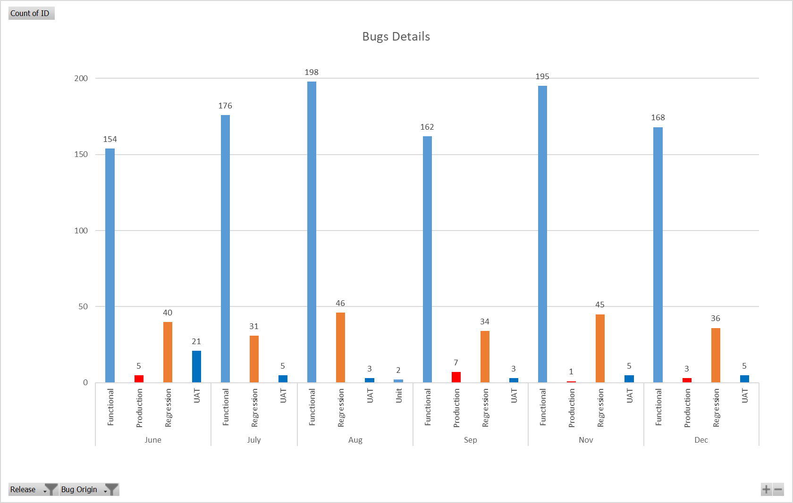
CT&M Dev: QA, Regression & UAT (Slide 2 of 2)
Amita/Sudhanshu
Notes:
Please copy wash.

Slide 19
CT&M Dev: Infrastructure & DevOps Update
Randy/Nitesh
*RAG | Infrastructure & DevOps Milestone​ | Target Completion Date​ | Impacted Release​ | Status | Action Plan / Notes​
G | Infra | Azure Portal COMPaaS Resource Utilization Optimization - 209881 | 1 mar. | March | In Progress | We are creating user story to optimize Micro services resource utilization and App services Plan optimization
G | Update COMPaaS DR Solution and SOP DR Document | 28 Jan. | January | In Progress | COMPaaS DR solution is updated as per current infra structure Updated DR document is in Review.
G | Configure APIM policy to secure Endpoints using ADB2C JWT Token - 194093 | 28 Jan. | January | In Progress | Changes applied till UAT.
Risks/Issues/Decisions/Information Needed
Key Updates
*RAG | Description | Impacts | Options | Owner
Info | Exploring DevOps to improve process and deployment time. | Continuous Improvement Area | Nitesh Sharma
Info | COMPaaS infra team actively analyzing the resource to optimize the ongoing running cost. | Continuous COMPaaS infra cost optimization | Nitesh Sharma
APIM JWT token policy changes done till UAT to enhance MS security.
Sprint 19,20 &21 changes deployed in UAT. Regression is in progress.
*For definition of RAG status, see here.
Notes:
Please copy wash.

Slide 20
CT&M Dev: Release and Environment Readiness Status
Randy/Nitesh/Islam
Environment Readiness – [1-Mar]
Ensure environment re-connectivity, if any Azure item added on servers
*RAG | Environment | RAG Owner | Start Date | Target Date | RAID | Action Plan / Notes​
 | Dev | Rishal Jha, Vimal Kumar, Pankaj Jha | 27-Nov | 5-Jan | None
 | QA | Meher Verma, Shalini Verma | 27-Nov | 5-Jan | None | Sprint 19 changes has been deployed in QA.
 | UAT | Meher Verma, Shalini Verma | 8-Jan | 19-Jan | None | Regression started on UAT env.
 | PROD | Randy Rahbar, Nitesh Sharma | 22-Jan | 26-Jan | None
Release Readiness – Scrum Teams [1-Mar]
Release Readiness – Infrastructure & DevOps [1-Mar]
*RAG | Release Parameter | Yes/No | RAID
 | Closure of all High Priority User Stories
 | Resolution of Inter-team dependencies
 | Availability of Resource key translation
 | QA Signoff
 | Product Owner Signoff
 | UAT Signoff by BA
 | Release Notes
 | Translations received and uploaded
 | Configuration document
*RAG | Release Parameter | Yes/No | RAID
 | Sitecore Rollout Documentation
 | CI/CD Pipeline and Configuration Management
 | Database Changes
 | Release Notes
 | Raise Change Request & Approval
*For definition of RAG status, see here.
Notes:
Please copy wash.

Slide 21
CT&M Development: Data Team Update
Shaikat
*RAG | Feature Name & Number | User Story Number | Sprint # | Sprint Deviation? | Predecessor Dependency RAG Status | RAID | Status | Action Plan / Notes​
G | 184548: CAN - Job Tracker > Ability to add Multiple comments per status | 214919 214920 | 1 | N |  | NA | Development | In Progress
G | 200913: Account Sync from SFDC to COMPaaS using IICS | 204181 204202 | 1` | N |  | NA | Development | In Progress
Risks/Issues/Decisions/Information Needed
*RAG | Description | Impacts | Options | Owner
G | Information: DEV Readiness: On track for both March and April Release, based on Matt's approval around Bulk load POC. Jan release: Preparedness On Track March Release: Sprint 1 Development started for in scope stories.
Post-Production Sync Status
Post-Production Issue Resolution
*RAG | Release | Status | Notes
G |  | NA | NA
*RAG | Release | Status | Notes
G |  | NA | NA
*For definition of RAG status, see here.
Notes:
Please copy wash.

Slide 22
CT&M Dev: Team Capacity Per Release
PMO
Available Capacity by Story Points
(Based on Current Release Allocation)
SCRUM Team | Story Point (SP) Capacity Per Release | Jan | Mar | Apr | May | Jun | Jul
Pioneers | 90 | 0 | 0 | 90 | 90 | 90 | 90
Navigators | 90 | 0 | 0 | 90 | 90 | 90 | 90
TopGuns | 90 | 0 | 0 | 90 | 90 | 90 | 90
Invincibles | 90 | 0 | 0 | 90 | 90 | 90 | 90
Achievers | 90 | 0 | 0 | 90 | 90 | 90 | 90
Miners (No development; Data Sync Only) | 40 | 0 | 0 | 40 | 40 | 40 | 40
TOTAL | 490 | 0 | 0 | 490 | 490 | 490 | 490
Notes:
Please copy wash.

Slide 23
Thank you

Slide 24
Appendix

Slide 25
CT&M Dev: Communications Rules
Sam
Background: Mixed information received from various IT team members about timelines/release assignments confuses our customers (P&I and Delivery Operations).
Communication Rules
Any communication directed to customers about CT&M Development workstream timelines, release assignment, etc. should only be made during the CT Program call, and made by Samantha, Caroline, or Geoff. (These three should always be aligned.)
Our customers should be removed and no longer involved in discussions where timelines are likely to be discussed. (For example, the Release Planning call.) The Product Owner team will represent the needs of the customer on all internal calls.
If a customer asks a question about a timeline/release plan, please decline to answer and indicate that you will notify Samantha or Harpreet of their question.
Notes:
Please copy wash.

Slide 26
Performance Testing Benchmarks
# | Performance Parameters | Benchmark
1 | GET API response with cache | 2 second
2 | GET API response without cache | 3 second
3 | POST API response without cache | 4 second
4 | Maximum response time for any API if it is returning huge data or any third-party communication is involved. | 5 second
5 | No of concurrent user | 100 active users across application at a given time
6 | Ramp up time | 15 sec for 25 user,30 sec for 50 user,45 sec for 75 user, 60 sec for 100 user
7 | Response time in peak load | Ranging from 5 sec to max 25 sec depending on scenario.
8 | Average 90% response time | It should be slightly greater than average response time.
9 | Browser average render time | 1-2 second
10 | Average Hit Per second | 30-40 hits per second for 100 user
11 | Median | 70% of the transactions took less time than average response time.
12 | UI and API response | Should not give timeout
13 | Endurance Testing Period | 15 mins, 30 mins, 60 mins, 120 mins, 180 mins
14 | Volume testing | Test with 100 users for resume and job transactions where CRUD operations are required in database. Business needs to confirm if they need more areas in volume testing.
15 | Error Rate | It should not greater than 1-2% of total transactions.
16 | Server Monitoring | AppInsights, Database, CPU, Memory and Disk monitoring with APM tool on server.

Slide 27
CT&M Dev: RAG Status Definition
Topic Workstream RAG Status Indicator
KPI : Schedule
KPI : Budget/Resource
KPI : Scope
KPI : Quality
KPI Definitions
Grey
Not started
Not started
Not started
Not started
Schedule – Refer Milestone Plan
Green
Delivery remains
ON Schedule without Risks
All resources are confirmed and not over-allocated
No unapproved Scope deviation
Quality of deliverable meets defined acceptance criteria
Budget – Planned vs Actual costs (CAPEX + OPEX)
* For Project Management only
Amber
Delivery schedule might exceed the 10% variation
Needed capacity or skillset will not impact Quality or Schedule by up to 10%
Identified changes will not affect Timeline / Resource Needs
Deliverables might not meet defined acceptance criteria
Red
Delivery schedule has or will exceed the 10% variation
Needed capacity or skillset will impact Quality or Schedule by 10% or more
Significant change will impact Schedule/Resource
Deliverable does/will not meet defined acceptance criteria
Resource – Capacity or skill-set aligned in the Project
Overall Topic Workstream RAG Status
If.....
Scope – Features assigned in a release
Green
ALL KPIs are GREEN
1 KPI is AMBER + 3 KPIs are GREEN
Amber
2 AMBER & 2 GREEN KPIs OR
3 AMBER & 1 GREEN KPIs OR
All KPIs AMBER OR
1 RED KPI with working mitigation in place
Quality – Acceptance criteria for each user story
Mitigation/Go Green Plan introduced and implemented
Red
1+ Unmitigated RED
Notes:
Please copy wash.

Slide 28
Workstream Governance: workstream governance
Workstream Office
Workstream Project Director
Program Office
Samantha Lafferty
David Scicluna
Stephanie Meder
Key:
Samantha Lafferty
LHH IT
Global Head of LHH IT Strategic Projects
Business Partner
Adecco PMO
Finance
Other LHH Department
Caroline Berman
Nina Jullian
Renato Sierralta
Coforge
Geoff Hutchinson
Shared Service / TAG
Workstream Domains
Workstream Domains
Project Management
Architecture
QA
Product Ownership
Business Analysis
Infra/DevOps
Scrum Teams
BizOps
Security
Domains Leads
Samantha Lafferty
Matthew Thiessen
Amita Kumari
George Goula
Laura Perez
Randy Rahbar
Islam Haider
Rob Bertrand
Greg Crease
Harpreet Chadha
Alana Carazón
Raj Pandey
Tausif Faridi
Bharat Pandey
Mukesh Kumar
Rakesh Khanna
Abhishek Gupta
Sudhanshu Pandey
Meher Verma
Shalini Verma
Courtney Cain
Harpreet Walia
Preetam Singh
Gudiya Rizvi
Gaurav Nalwa
Tarun Mogha
Indu Malik
Rajeev Verma
Samarth Chowdhary
Nitesh Sharma
Rishal Jha
TopGuns
Invincibles
Vimal Kumar Singh
Pioneers
Navigators
Shaikat Das
Miners Shalini Khanna
Achievers
Titans (Shaikat Das.)
Kim Glinsky
Michael Goins
Michele Hight
Workstream Team Members
Adecco Shared Services (APIM, Production Transition Services, ETL Data Sync Team)​
12 February 2024
Also internal customer
Notes:
Please copy wash.

Slide 29
Workstream Governance: internal customer groups
Below are the groups we will be enable and collect requirements from this year
Senior Leader
Jeff Smith
Federico Blasiotti
Katrina Villareal
Izabella Khazagerova
Thad Lawrence?
Team Name
BizOps
Security
Delivery Operations
New Tech Adoption & Usage
Connect Delivery Enablement
UAT Coordination
Product & Innovation
Privacy
Key:
Robert Bertrand
Greg Crease
Gina Potito
Caroline Lavanchy
Pieter de Vilder
Stephanie Meder
Elle Pyle
LHH IT
Team Lead
Other LHH Department
Kim Glinsky
Michael Goins
Michele Hight
Ad Hoc Basis
Ad Hoc Basis
N/A
David Scicluna
Guy Raviv
Brenda Johnson
Lauren Barron
Karen
Marybeth Bordeau
Karen Bieger
Marylene Chhiv?
Coforge
Team Members
Shared Service / TAG
Also workstream domain
12 February 2024
Notes:
Please copy wash.

Slide 30
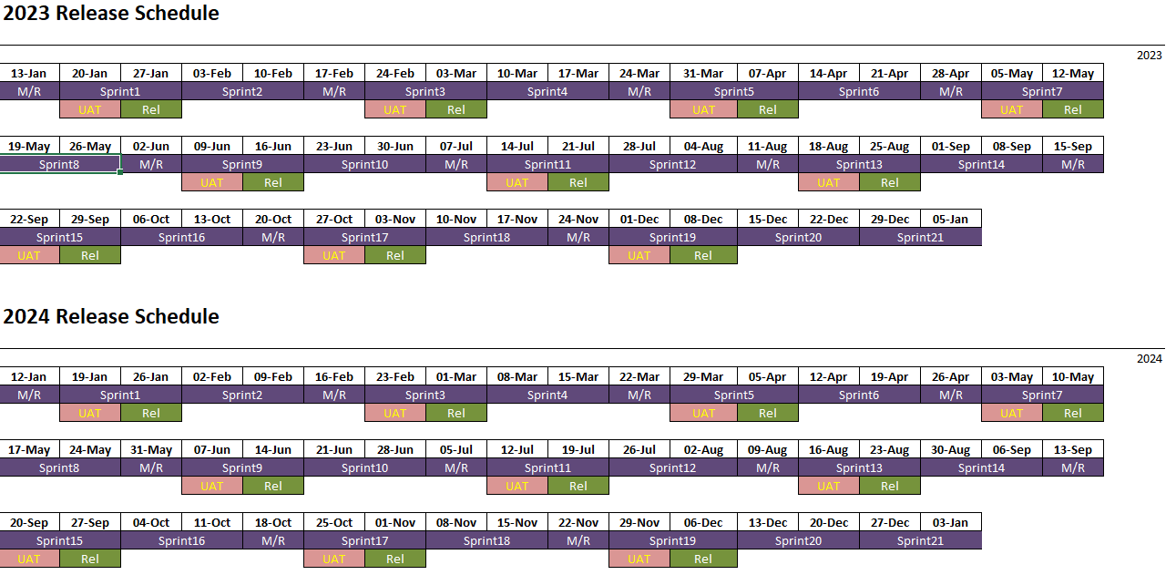
CT&M Dev: Release Schedule
Notes:
Please copy wash.

